Slide 1
Building Enterprise Information Technology and Mission Systems
Is it a Kobayashi Maru?
23 May 2023
Lt Col Edward “Ned” Jones
Materiel Leader, BMC3

Slide 2
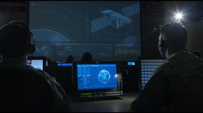
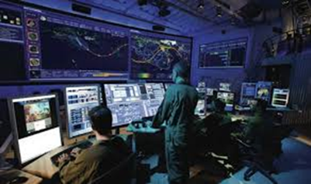
SPACE SYSTEMS COMMAND
Battle Management Command, Control, & Communications (BMC3)
Program Executive Officer (PEO): Brig Gen Timothy A. Sejba, USSF
Deputy PEO/Director: Ms. Shannon C. Pallone, NH-04, DAF
Purpose
Space Ground and Communications
Sustain and modernize the space ground architecture
Operational Command and Control
Deliver critical services to warfighters for timely, quality driven battlespace decisions in space domain fight
Provide infrastructure, enterprise services, and mission applications that enable responsive, resilient operational-level capabilities for space operations centers
Tactical Command and Control
Deliver cyber-secure tactical-level services using open standards and common platform that integrates capabilities across missions
Transition from legacy stove-piped ground systems to a framework for incorporating systems into enterprise capability
Mission
Deliver Resilient, integrated Space C3 systems to enable timely multi-domain warfighting
Vision
Seamless synchronized multi-domain fight
#SpaceStartsHere

Slide 3
Battle Management, Command, Control, and Communications (BMC3/BC)
PEO Chief Financial Officer
Mr. John Karns*
PEO & Director BMC3
Brig Gen Tim Sejba*
NH-04
SDA Executive Agent
Ms. Barbara Golf
HQE
Deputy Pgrm Executive Officer
Ms. Shannon Pallone
NH-04
Deputy
Director
Ms. Shannon Pallone
NH-04
IMA to the PEO
Col Stephen Yoon*
Lt Col Omar Perea
PEO Chief of Staff
Lt Col Brent Davis*
NH-04
Enterprise Data Architect
BCD
Operational Cmd & Ctrl
BCC
Tactical Cmd, Ctrl, Comm
BCT
NH-04
Data Transport Product Support
PM
SML
SML
SML
BCS
Ms. Sheryl Thorp
Col Cecilia Montes de Oca
Col Peter Mastro
Mr. Shawn Saywer
Cross Mission Data
BCCD
Information Mobility
BCTI
ML
ML
Lt Col Daniel Kimmich
Lt Col Louis Aldini
Battle Mgmt Cmd & Ctrl
BCCS
NH-04
Enterprise Ground Services
BCTG
ML
ML
Lt Col David Williams
Mr. Joshua Sullivan
Cmd & Ctrl SDA
BCCB
ML
Lt Col Edward Jones
Adv. Battle Mgmt Systems
BCCA
PM
Maj Tyler Carson
* Dual Hatted Across SZ & BC
PM
Engineering & Integration
BCE
NH-04
Operations Management
BCO
NH-04
Acquisition Logistics
BCL
NH-04
Contracting
BCK
Col Kenny Decker*
Mr. Anthony Towns*
Mr. Russell LaBelle*
Mr. Greg Brown
CAO 16 JAN 23
Notes:
2”, 2.75”, 3.38”, 4.01”, 4.64”, 5.27”, 5.9”, 6.53”
From Center
-5.7”, -3.8”, -1.9”, 0.2”, 2.1

Slide 4
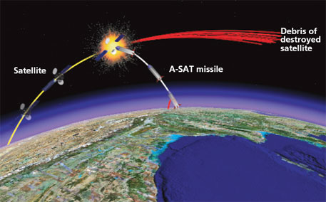
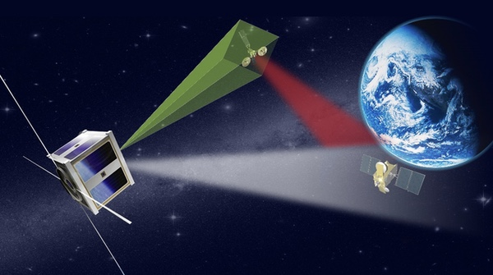
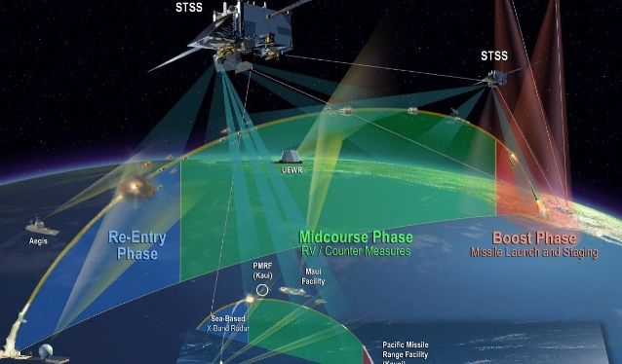
KILL CHAINS ANALYSIS
5 Kill Chains Are Lenses for Our Work
1) GEO Direct Ascent (DA)
Anti-Satellite (A-SAT)
2) GEO Co-Orbital Slow
3) LEO Missile Warning/Missile Track (MW/MT)
4) LEO Counterspace
5) Defensive Cyber Ops
Direct Ascent: weapons that use ground, air-, or sea-launched missiles with interceptors that are used to kinetically destroy satellites through force of impact, but are not placed into orbit themselves
Most US HVAs are in GEO
Shortest kill-chain timeline
ASATs can knock out multiple SVs at once
ASATs exist today/current threat
#SpaceStartsHere
Unclassified

Slide 5
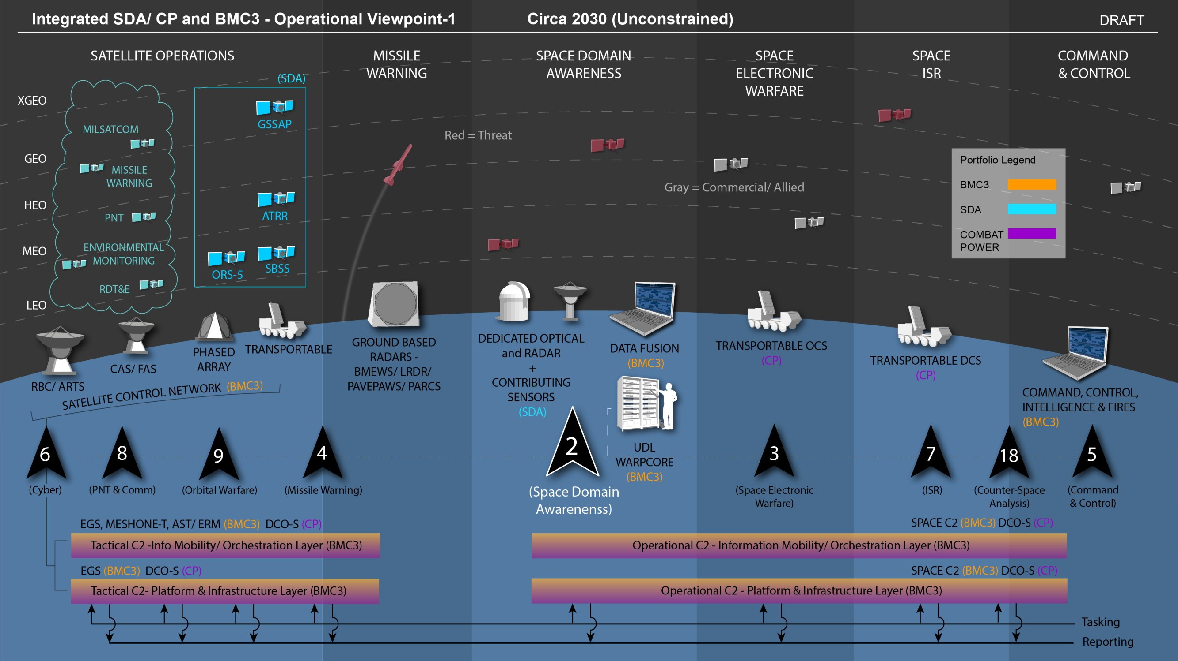

Slide 6
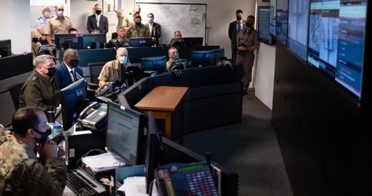
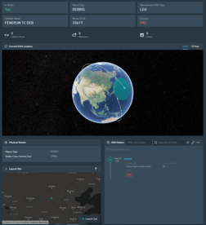
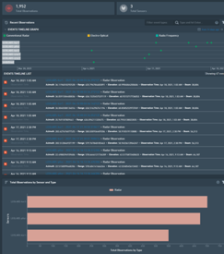
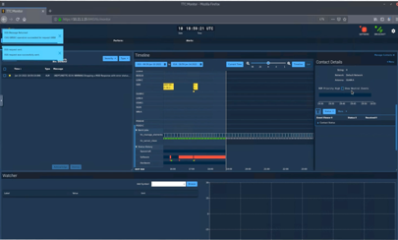
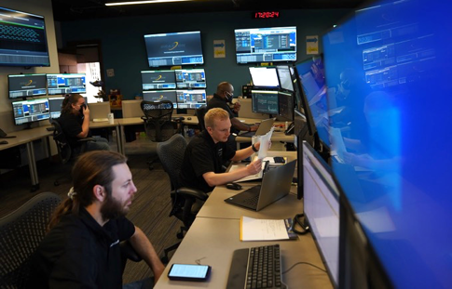
BMC3 Delivering Speed to Support Joint All-Domain Operations
“
”
Our ability to sense from the space domain, transport and make sense of data, and then get that data into the hands of our joint warfighting partners on land, in the air and at sea, is what the Space Force delivers to JADC2. Space capabilities underpin modern warfare.
Delivering capabilities enabling greater speed in space warfighting
Facilitating resiliency through enterprise solutions
GEN JOHN W RAYMOND, CSO
Space C2’s UDL & Warp Core
assisting in OAR/OAW
Warp Core
Data Curation
Astro User Experience
(UX) Dashboard
Information Mobility
CAS Operations Center
Notes:
Responsiveness and addressing threat by delivering capabilities that facilitate speed (acceleration) and resiliency
(Showcase of new example OV/Operational Scenario to provide context)
Delivering capabilities that enables greater speed in space warfighting by...
Accelerating decision making through enterprise data management, exploitation, and transformation (Space C2, UDL, Warp Core examples)
Space Fence / UDL example (linkages / synergy to SDACP portfolio)
Enabling space warfighting synchronization through automation that accelerates our ability respond, move, and maneuver (Examples from EGS, Information Mobility)
Common UX that facilitates efficiency, less training and speed for space operators (Astro, already being leveraged by govt & industry community)
Examples of KM applications that have already enabled greater speed
Facilitating resiliency through enterprise solutions
Common platforms, standards, and messages (EGS)
Expanding network capacity and increasing path diversity at multiple classification levels (i.e. AaaS, CAS, FAS)
Aging infrastructure and proliferating on orbit assets driving need for modernization efforts
Open architectures enabling resiliency though avoidance of vendor lock and cultivating and strengthening the industrial base (EGS)

