Slide 1
Space Vehicles Directorate
RV Overview
Col Jeremy A. Raley,
Director, Space Vehicles
Air Force Research Laboratory
AFCEA Luncheon
18 July 2023
DISTRO A: Approved for Public Release

Slide 2


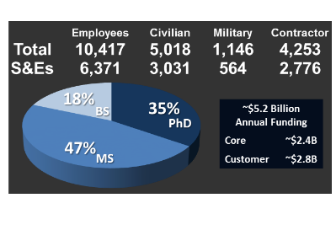




Information
Rome Research Site, NY
Wright-Patterson AFB, OH
AFRL HQ
711 Human Performance Wing
Sensors
Aerospace Systems
Materials and Manufacturing
Santiago, Chile
Arlington, VA
Kirtland AFB, NM
Office of
Scientific Research
Space Vehicles
Directed Energy
Arnold AFB, TN
Edwards AFB, CA
AFRL New Mexico
$660M Annual Economic Impact
2,167 Members of Workforce
1,999 Local Job Creation
Tokyo, Japan
London, UK
Maui Research Site, HI
Eglin AFB, FL
Munitions
DISTRO A: Approved for Public Release

Slide 3
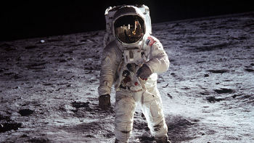

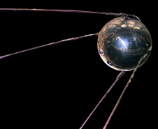
In the Mid-20th Century, the US and USSR raced to space
1969:
~1500 objects
7 nations in space
2 nations to the moon
DISTRO A: Approved for Public Release
Notes:
Not to scale.
50 years ago the drive to go to space was national, political, military. Epitomized by Sputnik and Neil Armstrong
Pictures from wikipedia

Slide 4


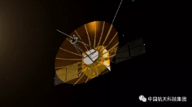

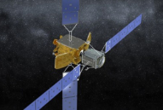
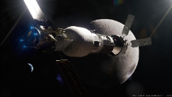




21st Century Space:
Economic & national interests driving 2nd space age
x12,000
x3200
Queqiao
India tests anti-satellite weapon
-Space News, 2019
MEV
Russian and US satellites collide
Lunar Gateway
x2500
-BBC 2009
1969 | Today | 2030+
~1500 objects | ~10⁴ objects Car-size, human-operated | ~10⁶ objects Shoebox-size, autonomous
<= GEO, Lunar, Keplerian | <= GEO, Keplerian | Cis-lunar sphere, non-Keplerian
~7 nations in space | ~12 Space faring nations ~90 nations w/ satellites | ?? Nations, non-state actors, corporations
Notes:
Graphics adapted from Distro A briefing. Table is the author’s read of the news and the tea leaves.
There is a ton of activity in space that is not being driven by government or military – commercial constellations, companies investigating on-orbit refueling and servicing (NGIS Mission Extension Vehicle), and activity going out to the moon with strong economic and “permanent presence” implications. In contrast to the 50s/60s, it isn’t just USSR vs US for military superiority or bragging rights; there is massive interest in the resources the moon (or even asteroids) could provide. As the Israeli lander attempt showed – it isn’t just the big business of big governments any more. Never mind LEO; the entire cis-lunar space is within reach of commercial enterprise.
Lunar stuff:
Upper left - Israel: selfie from Beresheet at about GEO -- https://phys.org/news/2019-03-israel-spacecraft-moon-selfie.html
Upper right - Chinese relay https://physicsworld.com/a/china-launches-queqiao-lunar-satellite/
Lower right - Cheng’e 4 picture taken from its Rover, https://www.nytimes.com/interactive/2019/01/03/science/china-change-4-moon-landing.html
Lower left - NASA lunar gateway from https://www.nasaspaceflight.com/2018/09/nasa-lunar-gateway-plans/
Earth stuff – constellations plus
Lower right - NGIS MEV from http://www.northropgrumman.com/Capabilities/SpaceLogistics/Pages/default.aspx
Not to scale.
Data is from Wikipedia. “nations” includes ESA
Constellations numbers are from wikipedia

Slide 5


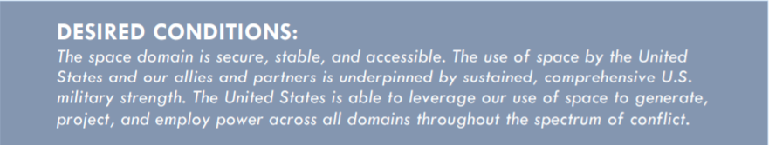
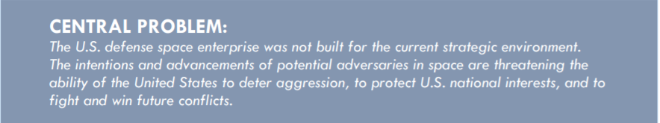
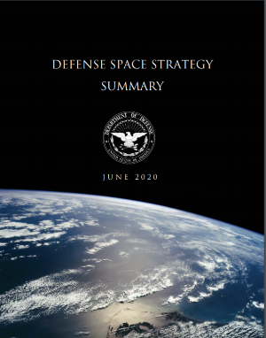
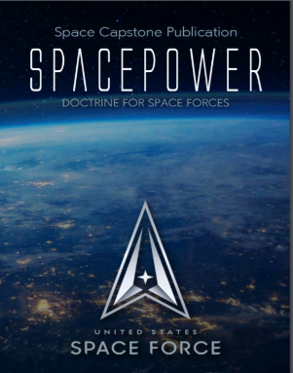
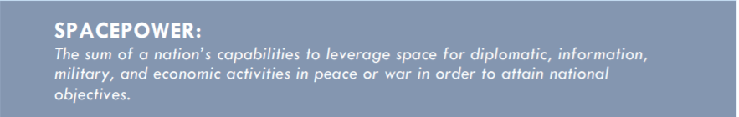
Changing Environment
DISTRO A: Approved for Public Release

Slide 6


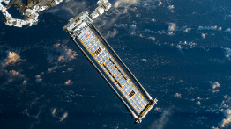
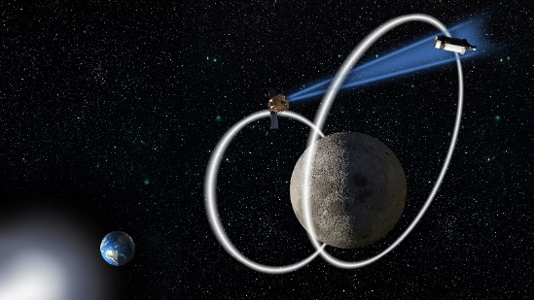
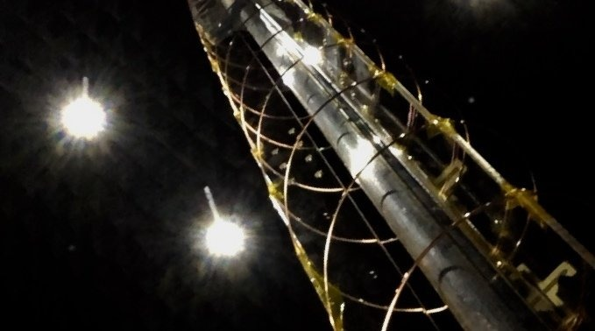
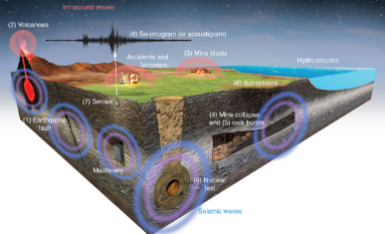
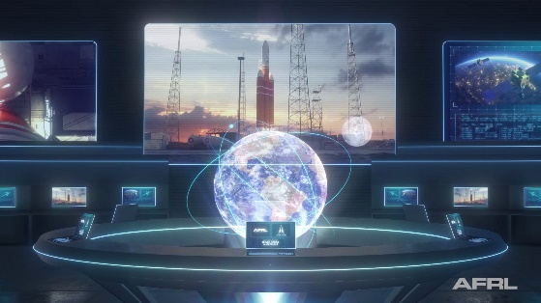
AFRL/RV Mission Areas
Satellite Communication and PNT
Missile Warning & Tactical ISR
Space Environment
Pervasive Technologies
Quantum Sensing
Ionosphere Science
Imaging Sensor Calibration Lab
Roll-Out Solar Array
Robust and resilient PNT
Wide- and narrowband comm
Quantum sensing and timing
Novel detectors and materials
Data processing & algorithms
Infrared Radiation Effects Lab
Wave impacts on radiation belt
Effects on systems and services
Monitor, forecast, and mitigate
Power, structures, electronics
Space logistics and maneuver
Size, weight, power and cost
Space Control
Small Satellite Portfolio
Nuclear Deterrence Operations
Agile Software Operations
Oracle
XVI
Antenna
Cislunar Situational Awareness
Multi-agent autonomous ops
Cyber protection, hardening
Proving cubesat military use
Cost efficient tech experiments
University Nanosat Program
Inertial navigation systems
Nuclear Explosion Monitoring
Hypersonic modelling & sim
Software factory, SecDevOps
Unified Data Library market
User interfaces, decision aids
DISTRO A: Approved for Public Release

Slide 7

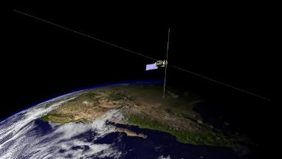
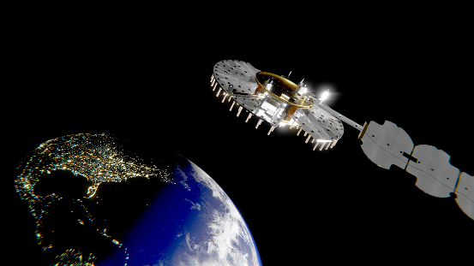





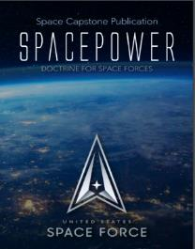




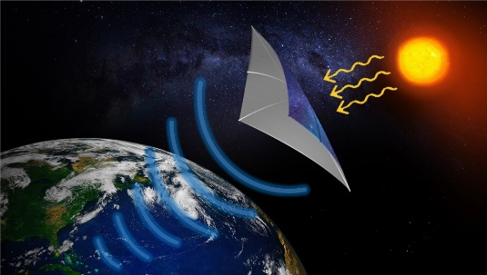







S&T Aligned to SPACEPOWER
Demonstration and Science Experiments
Navigation Technology Satellite 3
Combat Power Projection
Information Mobility
Discovery of new space environment science
Robust, resilient position, navigation, and timing
Space Logistics
Space Mobility & Logistics
Maneuver without regret enabled by space logistics
Space Solar Power Research
Oracle
Space Security
Space Domain Awareness
Enabling green energy and energy independence
Pushing domain awareness into cislunar space
DISTRO A: Approved for Public Release
Notes:
DSX – Demonstration Science Experiment
HANE – High Altitude Nuclear Explosion
MAFS – Mathematically Assured Flight Software (cyber)
NTS-3 – Navigation Technology Satellite 3
WSCE – W/V-band Satellite Communication Experiment
MANNA -
SDUE – Software Defined User Equipment
EXTRASpace – EXtremely Thin RF Apertures
AMOS – AFRL Maui Optical and Supercomputing Site
SOR – Starfire Optical Range
XGEO – beyond GEO (multiples of GEO)
HAD – Hybrid Architecture Demo
MSMU – MicroSatellite Military Utility
ADOX – Autonomous Depot Operations in XGEO

Slide 8


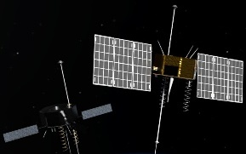
Navigation Technology Satellite -3 (NTS-3) Space Vanguard
Position, navigation, and timing have never been more important or pervasive
  Global utility: air traffic control, banking, farming, search-and-rescue, cellular networks,
Two satellite navigation experiments were launched by the United States in the 1970s
  NTS-2 was followed by 40+ years of GPS
  NTS-3 will be the first US DoD experimental navigation satellite in 45 years
New Technologies being tested
  Reprogrammable signals
  Reprogrammable receivers – user equipment
  Flexible timekeeping – improved time
  Advanced electronically scanned array antennas
  Responsive ground control
NTS-2
1977
NTS-3
2023
NTS-1
1974
NTS-3 will test on-orbit reprogrammability, enabling broadcast of new signals to improve performance by avoiding and defeating interference and adding signatures to counter spoofing
DISTRO A: Approved for Public Release

Slide 9
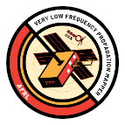
Remediating the Environment
SPACE INJECTION
80m boom
16m boom
~ 500 kg
3-axis stabilized
VLF transmitter
Radiation sensors
AFRL is leveraging its space environmental expertise to develop methods to recover after a High Altitude Nuclear Explosion event
MODELS
PREDICTIONS
Satellites test the predictions by injecting weak radio waves and observing their effects
Models predict the performance of injecting radio waves
RADIO DIAGNOSTICS
1m dipole
Magnetic search coil
6U cubesat
3-axis stabilized
VLF receiver
Validated predictions, theory, and discovered new response mechanisms
AFRL working to mitigate a long-standing threat to low Earth orbit
DISTRO A: Approved for Public Release

Slide 10
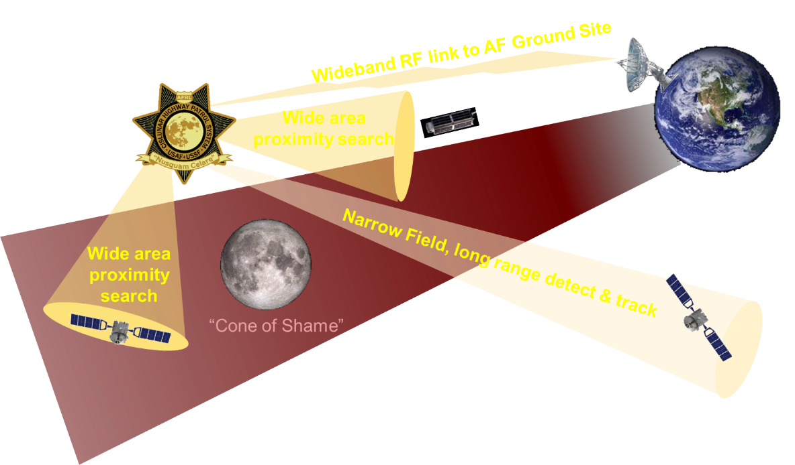
Oracle
Objectives
  Find, fix, and track objects in the “Cone of Shame”
  Demo tip & cue with existing ground and space assets
  Explore new orbit determination on objects cislunar space
  Assess novel navigation techniques 3-body space
Oracle
On-board Object Detect
Autonomous orbit determination
Autonomous path prediction
Real-time ground alerts
Continuous, autonomous
tracking
Automatic re-point
for target track
DISTRO A: Approved for Public Release

Slide 11
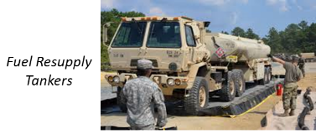

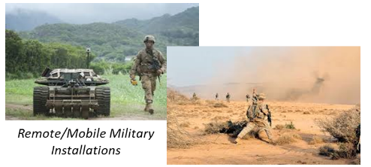
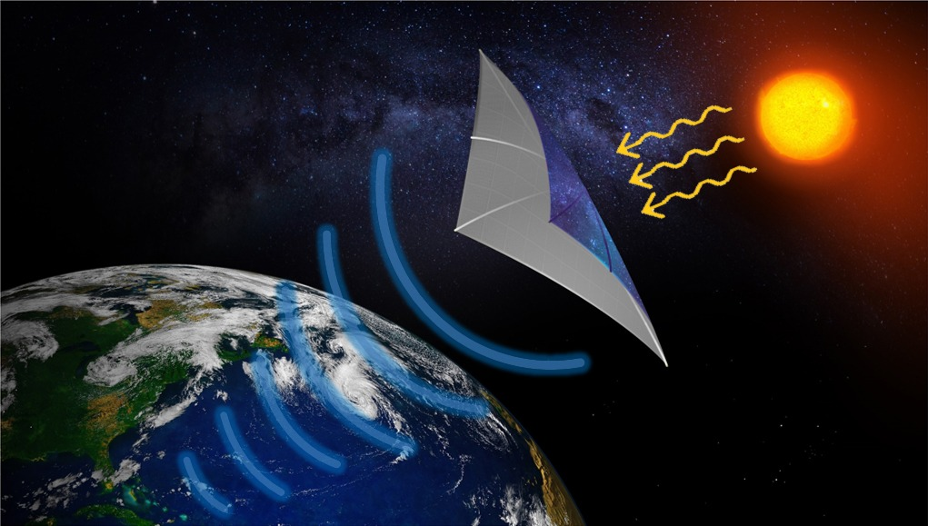
DoD Motivation for Space Solar Power
Reduce logistics burden
Minimize energy resupply risks
Transition away from fossil fuels
Increase energy architecture flexibility
Inevitability of new operational concepts
Eliminate Fuel Resupply Tankers
Clean Energy
Space Solar Power Incremental Demos and Research (SSPIDR)
Remote/Mobile Military Installations
DISTRO A: Approved for Public Release

Slide 12
Prioritized Initiatives
Path agnostic communication
Managing hybrid architectures
Low-cost satellite protection technologies
Autonomy, Artificial Intelligence, and multi-agent collaboration
Space cyber hardening and protection
LEO to cislunar space domain awareness
Modeling and simulation concept analysis for data-driven decision making
Space logistics, e.g. servicing/upgrade, assembly, and manufacturing
Space to surface sensing
Clean sheet command, control, and communications architecture
Space environment
Space-based terrestrial environmental monitoring
DISTRO A: Approved for Public Release

Slide 13
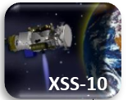
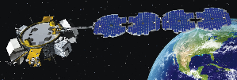
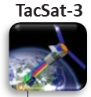
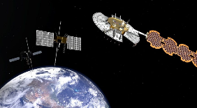
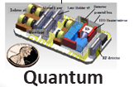
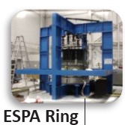
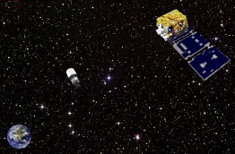
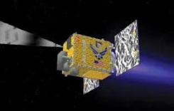

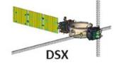

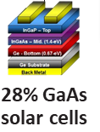
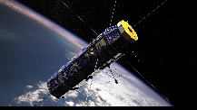
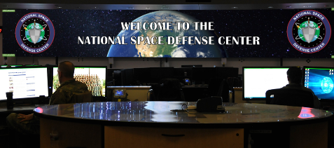

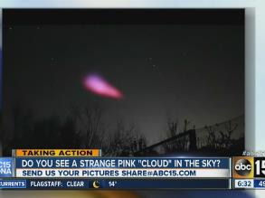
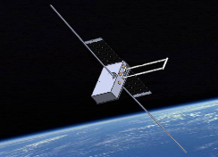
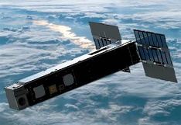
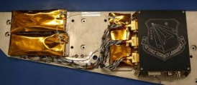
EAGLE
Quantum
NTS-3
ANGELS
XSS-11
ROSA
Oracle
2000
2005
2010
2015
2020
2025
2030
C/NOFS
NSDC
SSPIDR
Ionosphere test
SHARC
VPM
ASETS-II
DISTRO A: Approved for Public Release

Slide 14
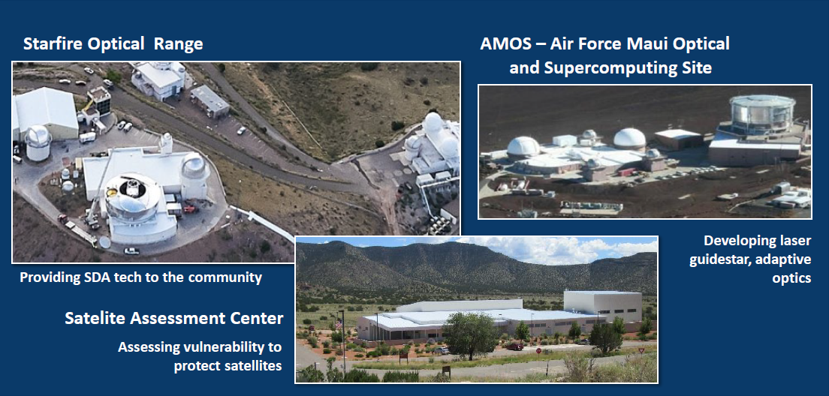
AFRL/RD Directed Energy support to the USSF
One AFRL Two Services
Distribution A: Approved for public release: distribution unlimited

Slide 15




Investing in New Mexico - Recent Economic Development Initiatives
Career STREAM: $1.6M for summer STEM apprenticeship program for New Mexico high school students (NM Tech)
Q Station EDA Grant: ~$1M for Space and DE economic development programming (New Mexico Trade Alliance)
Hyperspace Challenge - University Edition: $500K to expand into connecting universities to Space Force problems (CNM Ingenuity)
Space Force University Consortium Research Opportunity: ~$3.5M for building workforce and research capacity for Space (University Space Research Associates)
Space Innovation Hub: ~$7M for space economic development initiatives (New Space New Mexico)
Directed Energy Center: $2.5M to develop a workforce pipeline and research capacity for Directed Energy in New Mexico
Distribution A: Approved for public release: distribution unlimited

Slide 16
Questions?
DISTRO A: Approved for Public Release

