Slide 1
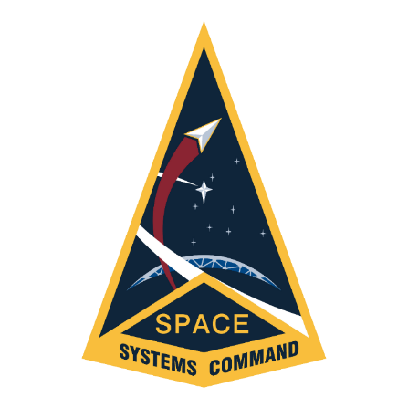
Space Systems Command/International Affairs (SSC/IA) AFCEA Presentation
UNCLASSIFIED
Pic 2
Deanna Ryals
Director
The United States can meet the challenges of this decisive decade only by partnering with countries and people around the world. – NSS 2022
This information is furnished on the condition that it will not be released to another nation without specific authority of the Department of the Air Force of the United States, that it will be used for military purposes only, that individual or corporate rights originating in the information, whether patented or not, will be respected, that the recipient will report promptly to the United States any known or suspected compromise, and that the information will be provided substantially the same degree of security afforded it by the Department of Defense of the United States. Also, regardless of any other markings on the document, it will not be downgraded or declassified without written approval of the originating U.S. agency.
UNCLASSIFIED

Slide 2
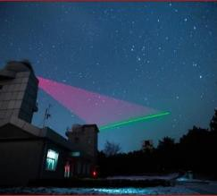
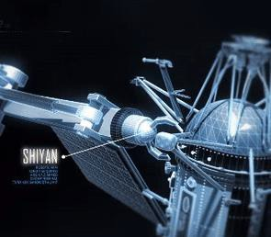
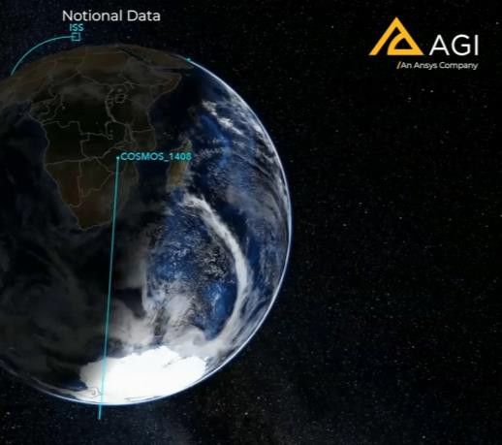
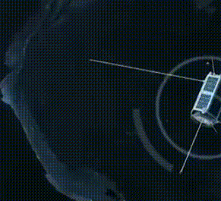
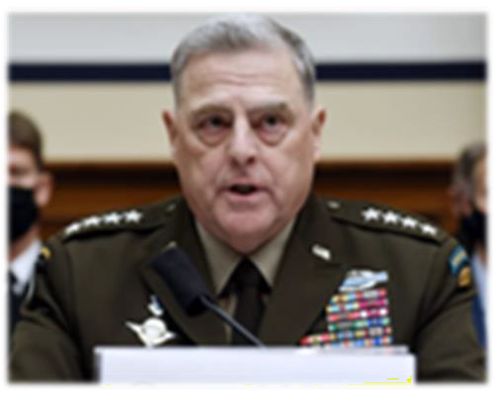
UNCLASSIFIED
What motivates us?
Top U.S. general
calls China’s
hypersonic weapon test very close to a ‘Sputnik moment.’
China launches world’s first quantum communications satellite.
China is launching
‘kidnapper’ satellites, with grappling arms capable of plucking satellites out of orbit.
Russian direct-ascent anti-satellite missile test creates significant,
long-lasting space debris.
Russia has a new weapon
that USSF dubs the ‘Nesting
Doll.’ It opened up and another satellite came out. And it opened up and a projectile came out. That projectile is designed to kill U.S. satellites.
"The world is becoming an increasingly dangerous place and preserving US national security interest in space is growing hard everyday...A resilient, ready and combat capable Space Force is indispensable to deterrence today, tomorrow and every day after that.”
Gen. B. Chance Saltzman, Chief of Space Operations, U.S. Space Force
UNCLASSIFIED
Notes:
When comparing capabilities in the space domain, after the US, it is China and Russia, then everybody else.
CHINA:
To this point, five years ago China was becoming a rapidly growing space power and was starting to legitimately contest Russia’s position as the clear number 2 behind the US. Today however, it is clear that China didn’t just succeed in their challenge, they continued to accelerate and blew past Russia to the point that now China is challenging the US as the pacing power in space technology
To scope China’s progress with numbers, they have seen a nearly 2000% increase in on-orbit presence over the past 15 years (they had 30 satellites in 2006, now they have 600).
Beijing also recognizes the shift in innovation from the government to the private sector and in 2014 opened the space industry to private investment for the first time. Since then, commercial space companies of all kinds have sprung up all over China. While these companies are still a far cry from their Western counterparts in terms of capability and market presence, they nonetheless continue to secure massive amounts of funding from both within China and abroad.
For its part, the PLA believes space is critical to modern “informatized” warfare. That is, space is critical to winning the information fight, and winning the information fight is critical to winning in the air, on land, and at sea. And Beijing put its money where its mouth is, establishing the PLA Strategic Support Force in 2015 to control the military information space, and its subordinate Space Systems Department is effectively China’s version of the US Space Force.
However, China is not content to merely compete with US space capabilities, it wants to knock out these capabilities in order to establish space superiority. To this end, China is developing a vast array of counterspace weapons.
Russia:
If China is the pacing threat, Russia has remained relatively static, able to maintain its existing expertise and performance, but struggling to match the rapid strides now being taken by the US and China.
At the end of the day, Russia is still the country of Sputnik and Yuri Gagarin. They are not going to go quietly in the space domain, and being a “space power” probably means more to Russia than any other country. The fact is that the country still has a lot of residual capacity and expertise with which to conduct space operations, and they remain among the best in the world in some niche capabilities, such as rocket motor manufacturing and human spaceflight.
Russia certainly has its challenges, though. As the Russian economy continues to decline, the space program(s) have had their budgets slashed repeatedly. Corruption is a huge problem, with the single-worst example probably being construction at the new Vostochnyy Cosmodrome in the Far East which has seen a series of corrupt construction companies get busted for embezzling millions upon millions of dollars.
The skilled workforce has also been difficult to maintain, due in large part to “brain drain” which has seen the most skilled and marketable talent depart for better climes. Quality has suffered as a result. Perhaps more to the point, Russia’s almost wholly state-owned space infrastructure has been almost entirely unable to compete against nimble Western companies, putting Russia further behind the barrel.
Lastly, sanctions have taken their toll. Russia’s domestic industries have minimal ability to produce high-end electronic components (such as microchips) needed for things like spacecraft, a fact lamented by Roscosmos Director Dmitry Rogozin in June 2021 when he told Russia’s Parliament “dozens” of satellites had been impacted, saying “We have more than enough rockets, but there’s nothing left to launch.”
ROGOZIN QUOTE: “The launch of a number of satellites has been disrupted due to sanctions… We have more than enough launch vehicles, but there’s nothing to launch. Because spacecraft, which are almost ready, are standing idle. One, another, a third just lack one microchip, which we can by no means purchase due to sanctions.”
Meanwhile, Russia still maintains a significant on-orbit presence just shy of 200 satellites (see slide 7). This is more than almost every other country in the world, but pales in comparison to what the US and China in particular have up.
Perhaps to make up for this growing gap in capabilities, Russia is also developing an array of counterspace weapons. While Moscow only rarely acknowledges its work in this area, it does comparatively little to actually hide it, as will be seen in the next few slides.
The bottom line here is that both China and Russia, despite their persistent accusations that the US is solely to blame for militarizing space and starting a counterspace arms race, are actively building out their space and counterspace capabilities which now pose a grave threat to US space capabilities, holding at risk the space assets which underlie our military, economy, and society.

Slide 3
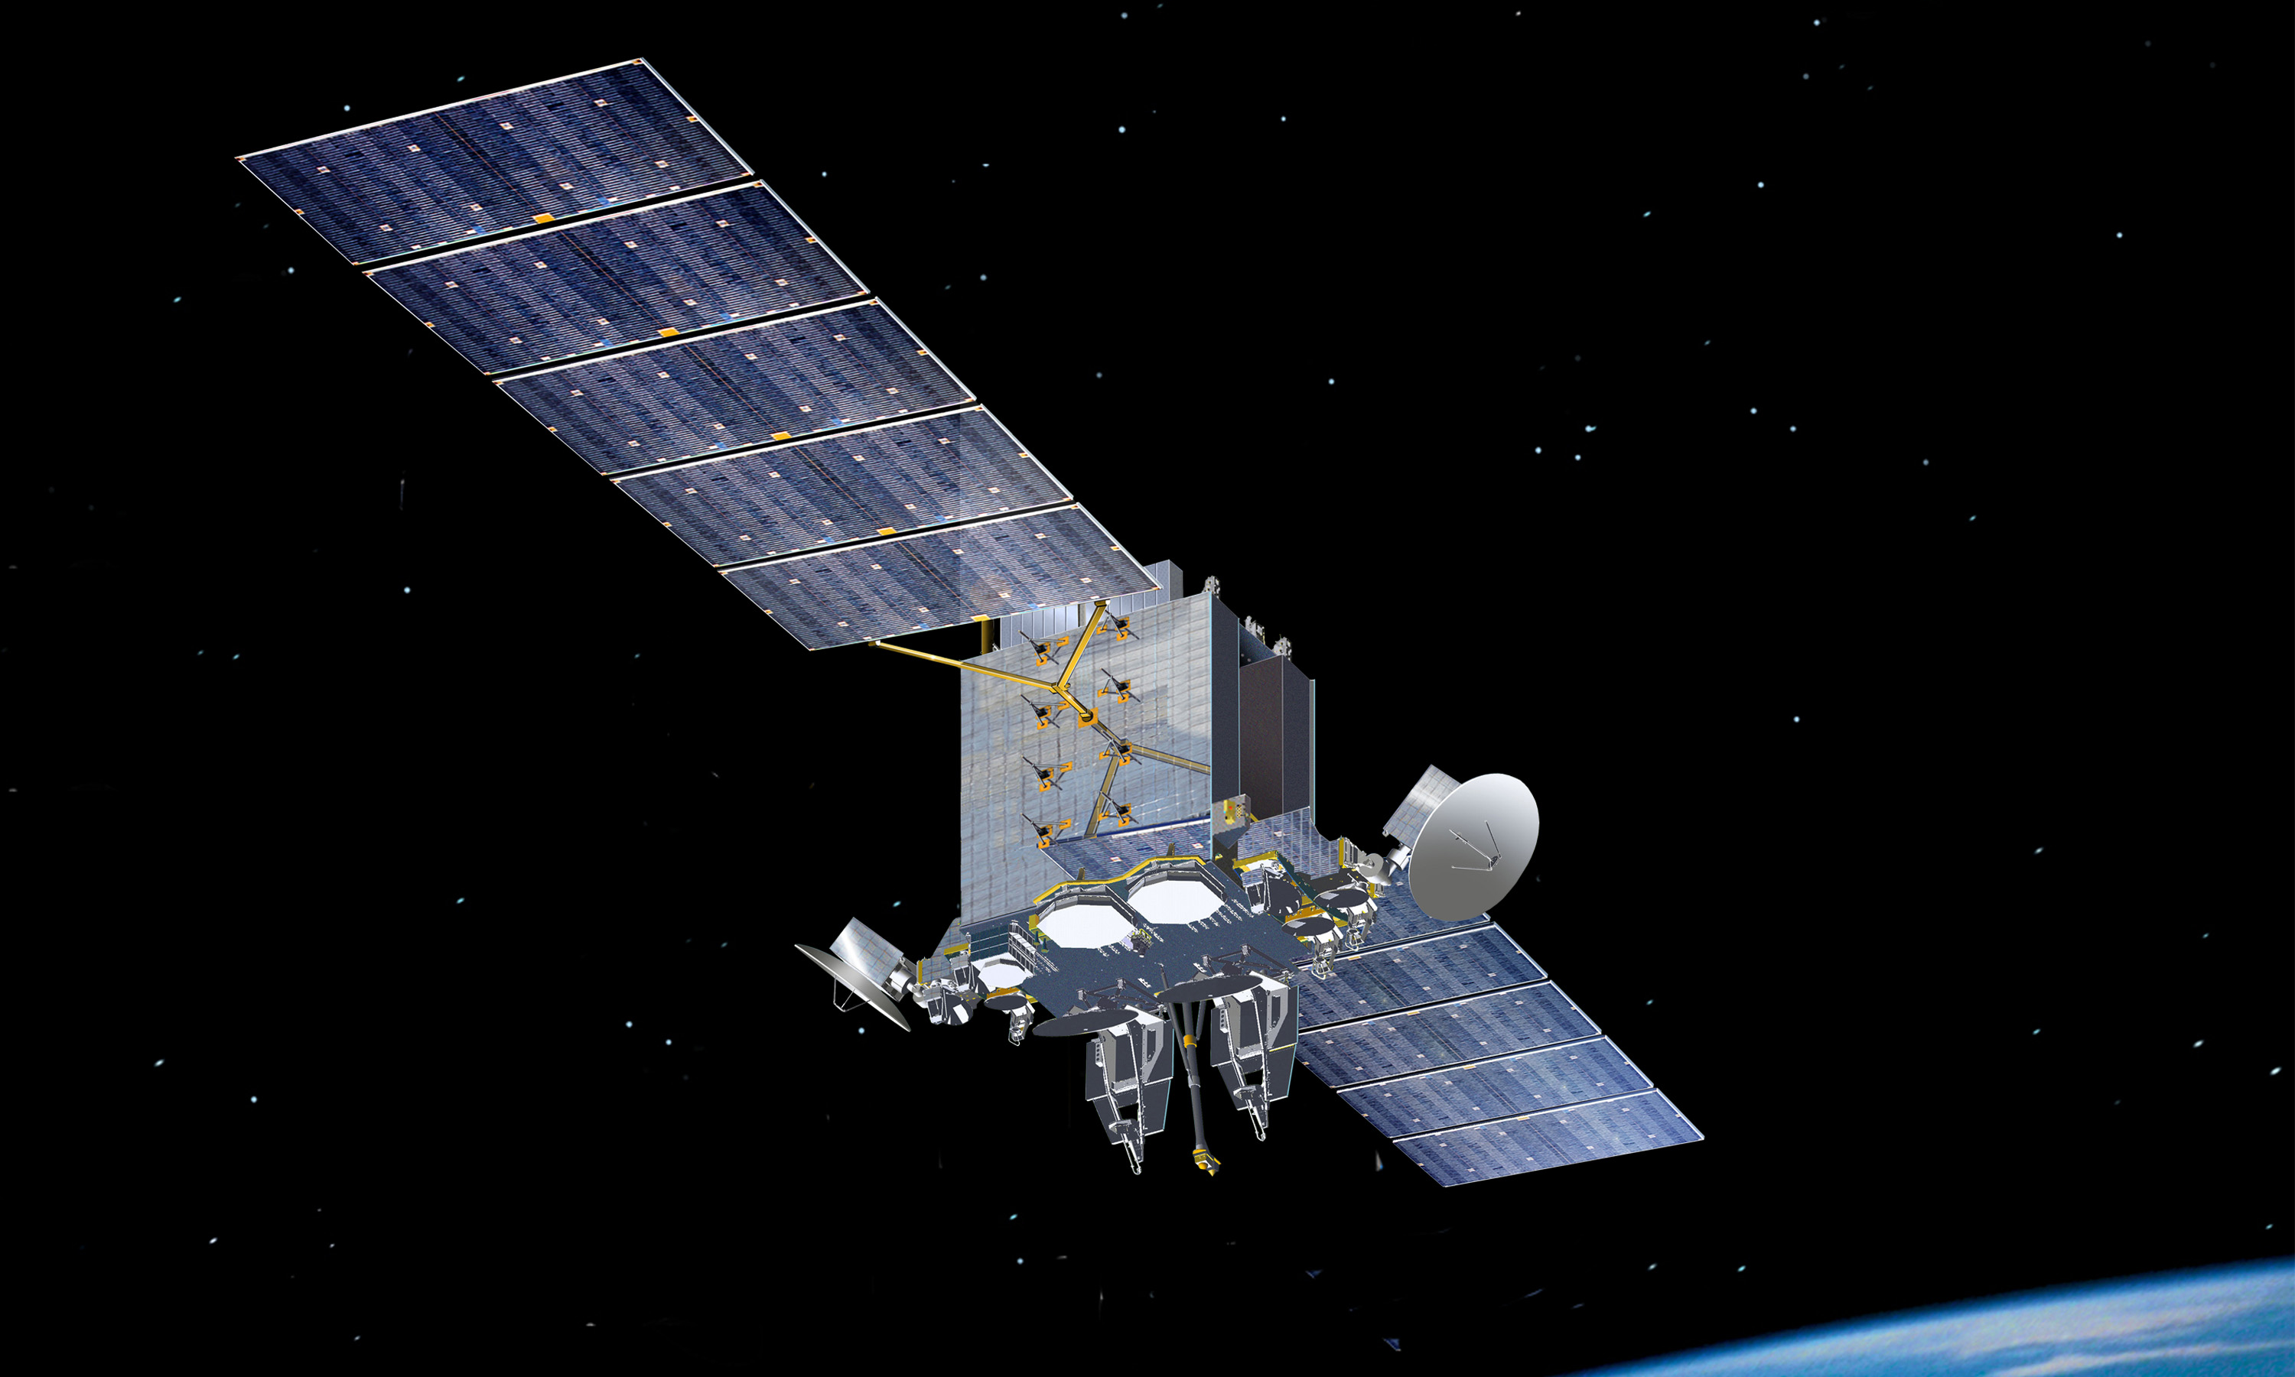
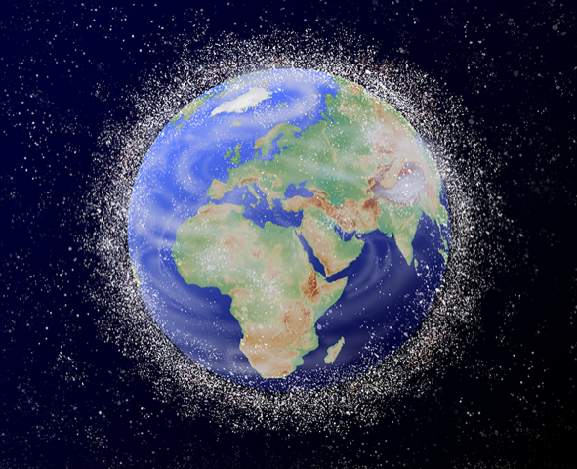
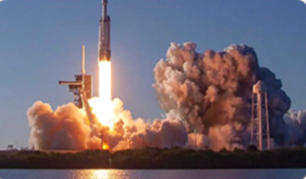
Getting after the 2026 fight –- Through Partnership
UNCLASSIFIED
SPACE SYSTEMS COMMAND
“Exploit” capabilities
(US and Allies)
Buy what
we can
Build what
we must
Kirtland AFB, NM
AFRL – SpaceWerx
Development Corps Innovation & Prototyping Directorate
Rendezvous and Proximity (REPR) Satellite Operations Center
Small Launch and Targets Division
DoD STP Division and STP Human Spaceflight Payloads Branch
Building a Constellation of Partnership: Threat-focused, Allied by Design
CAO 4 Jan 23_V1
UNCLASSIFIED
Notes:
-Exploit what we have “Fight Tonight”
Resource Sustainment
Integrate & Network Capabilities
Close relationships with operational Deltas
-Buy what we can “2026 Fight”
COMSO
SSC Front Door
Innovation Houses
SpaceWERX, etc…
International
Commercial Ride Shares
Dual-Use Tech
-Build only what we must “Inherently Governmental
SSC’s traditional core competency
Where the resources are
PMs incentivized
SWAC Force Design
MW/MT, etc.
(Needs culture shift)
Examples of Exploit/Buy/Build (SSC/IA recent accomplishments)
-US/LUX GCC SATCOM SP through NSPA
-SSC/IA with POL on SpOC
-SSC/IA with UKR regarding Iridium/Starlink
-DARC negotiations, assisting SAF/IA with RFA to conclude process with OSD
-WGS-12 with JPN and POL
-STAR Baseline successfully achieved 2-letter coordination, handed off to SAF/IA

Slide 4
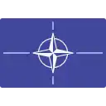
UNCLASSIFIED
SSC’s Global Constellation of Partnership
Organization:
Two-letter direct-report to SSC/CC
Close coordination with SAF/IA and S5P
Mirrors PEO structure, separate FMS Division
SSC OCONUS: AUS, BEL, DEU, and JPN
3xUK LOs, 1xDEU engineer
On the Horizon:
International interfaces and standards for Allies
JCO: Fly-away kits, 24/7 global operations
Meridian (EUR) and INDOPACOM (AUS) Cells
On-Orbit Service and Maintenance (OS&M)
Rocket Cargo and Orbital Debris Mitigation
Services-Based Partnerships (all missions)
Hosted/Hosting payloads
Allied Tactically Responsive Space/Allied Alternate PNT
NATO
NOR
LUX
DNK
SWE
GBR
DEU
EST
CAN
BEL
POL
UKR
FRA
ROU
CHE
Space Capability Development:
92 completed agreements
16 countries
>$76B in Allied contributions to national security space architecture
ITA
ISR
CZE
QAT
KOR
KSA
JPN
Space FMS Development:
GPS Cases Worldwide​ (~400)
437 Space FMS cases
12 LoRs/LoAs (SATCOM, SDA, Space EW, and Commercial)
SEWS​ Cases (11)
CSCO Cases (9)
Space Launch Delta (SLD)-45 Cases (5)
USAI Cases (3)
$570M currently in work
PER
BRA
CHL
AUS
URY
NZL
UNCLASSIFIED
4

Slide 5
UNCLASSIFIED
Recent/Future Events
Recent
Monterey Global Partnerships Conference
Colombian Air Force (COLAF) Visit
JPN Space Engagement Talk (SET)
Future
Defence In Space (London, UK) (3-4 Oct)
NNSA-Sponsored International Security Space Forum (Chantilly, VA) (23-24 Oct)
SSC-Sponsored International Reverse Industry Days (Chantilly, VA) (25-26 Oct)
Space Technologies and Resources (STAR) Baseline (late Summer 2023)
5
UNCLASSIFIED
Notes:
Past
-Monterey Conference (discussed requirements, supply chain discussion – industry, government)
Future
-UK Space Commander (additional date)

