Slide 1
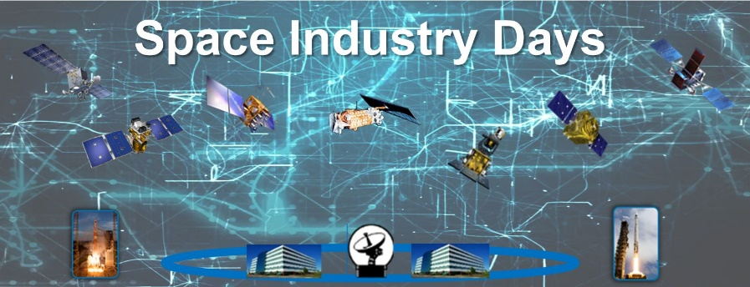
Space Industry Days 2021
October 20-21, 2021
In-Person
&
Online
Special Room Rates
Register Now
https://afcea-la.org/
Sponsorships available
Space Industry Days sessions are open to all government, industry partners and contractors. The sessions will feature government and industry speakers discussing current initiatives and emerging challenges.
Space Industry Days intends to have an agenda this year spanning two full days and including the following proposed events: – Keynote speech from SSC/CC – SAF/AQS and USAF/USSF leadership speeches – Updates from SSC Corps and PEOs (Atlas, Enterprise, Development, and Production Corps) and the Portfolio Architect – Perspectives from the Space Rapid Capabilities Office, Space Industry Panel, Small Business Panel, and other possible panels – Opportunities for side sessions with “Meet the PMs” (in-person only) – Exhibit hall (in-person only)

